Slide 1
Churn Prediction POC Approval
Ravenstack has lost
$14.1M to churn.
A decision-support tool that tells the customer success team who to call — before the customer cancels.
Markus von Aschoff · markus@vonaschoff.de · June 2026
01

Slide 2
02 · THE PROBLEM
Customers cancel. Nobody sees it coming.
LOST TO CHURN SO FAR
ANNUAL CHURN RATE
AT RISK NEXT 12 MONTHS
$14.1M
12.1%
$47.2M
ARR from cancelled accounts, ‘23–’24
Annualized from 22% cancellation ‘23-’24
At the 4%/month SMB SaaS benchmark
Key Insights
53% of all churn happens in the first 90 days after signup, often before teams notice a customer is at risk.
DevTools with 31% highest churn rate.
CyberSecurity with $3.3m highest ARR churn.
02

Slide 3
03 · THE SOLUTION
A weekly ranked list of who to call — and why.
1
2
3
Score
Explain
Deliver
A model ranks every account by churn risk: account age, segment, usage trend, contract type.
Claude turns each score into one sentence a CS manager can read in 5 seconds and act on.
n8n runs the whole flow on a schedule and posts the digest to the team's Slack channel.
Recommendation AI · rule-based, upgrades to ML
Generative AI · one API call per week
Automation · 8 nodes, no code to maintain
Every Monday, all 390+ accounts, flag the top 20 at risk. The model recommends. The CS team decides.
03
The model recommends. The CS team decides. No message ever reaches a customer automatically.

Slide 4
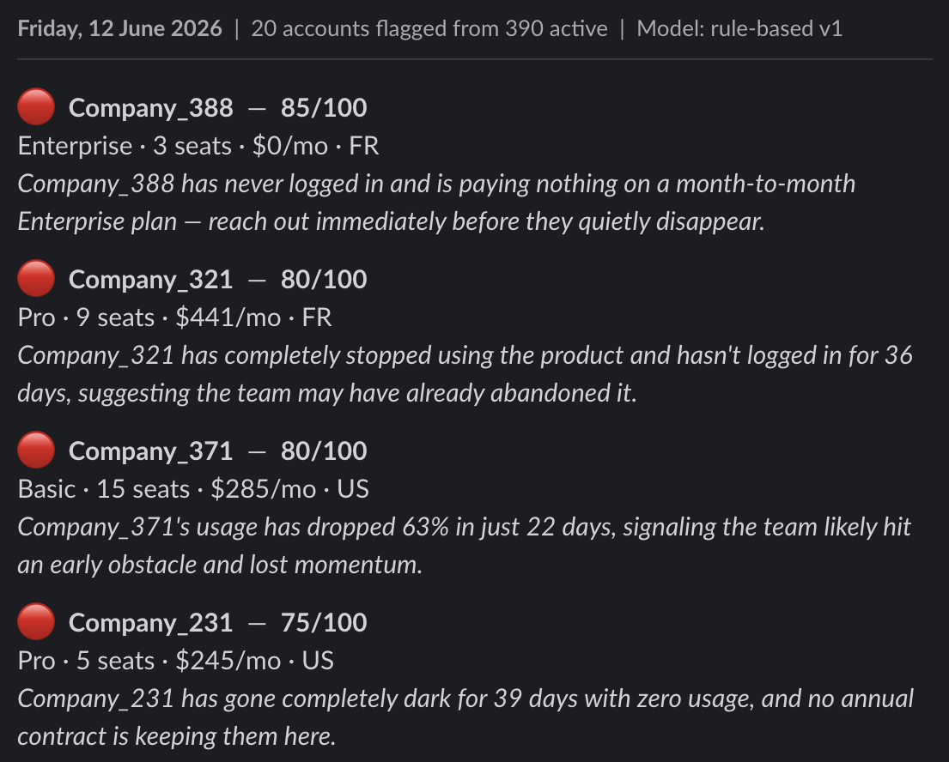
04 · PROOF OF CONCEPT
It works today. The digest arrives in under 30 seconds.
How it runs
What the team sees
1
Monday 8 AM — the schedule fires
2
Score all 390 accounts, return top 20
3
Claude writes one reason per account
4
Format and post the digest to Slack
04
Built with n8n and the Anthropic API. The POC proves the plumbing; the pilot proves the alerts change outcomes.
Decision whether on-prem deployment with Python, local LLM or N8N/Anthropic

Slide 5
05 · THE BUSINESS CASE
Payback in month 1.
COST TO BUILD
ARR SAVED / YEAR
RETURN AT 12 MONTHS
$10K
$1.09m
3,521%
Upfront, Phases 1–3
Assuming 15% - case studies at 5-25%
5,735% over 36 months
05
Biggest assumption: a 15% save rate. Honest, and conservative — the pilot measures the real number against a control group.

Slide 6
06 · TOP RISKS
Three risks could derail this. All three are managed.
The model drifts as the product changes
HOW WE MANAGE IT
Retrain monthly. Detect drift weekly — flag any input that shifts more than 20% from its training distribution.
Likelihood 4 × Impact 3 = 12
The CS team stops trusting the alerts
HOW WE MANAGE IT
The team rates alerts from week one. If reaction rates fall below 50% for two weeks, the workflow pauses and we investigate.
Likelihood 3 × Impact 4 = 12
Customer data crosses borders (GDPR)
HOW WE MANAGE IT
Check if the Anthropic and Slack data processing agreements are signed. Send account IDs, not names. No individual personal data in prompts.
Likelihood 2 × Impact 4 = 8
06
None of these are blockers. Each has a named mitigation and a clear trigger for action. The risks are manageable.

Slide 7
07 · COMPLIANCE
Deployable compliantly. Here's why.
EU AI ACT
GDPR
Class: Limited Risk
Basis: legitimate interest
Not in any high-risk Annex III category. The LLM text shown to staff triggers Article 52 transparency duties.
Art. 6(1)(f). Aggregated B2B account data only — no individual personal data in prompts.
Obligation: met
Subject rights: supported
Every digest is labelled 'rule-based v1'. The AI is disclosed from day one.
Access, erasure, rectification, objection. Accounts can be excluded from scoring on request.
Gap to close
Gap to close (if not yet done)
A short written policy telling the CS team what the model does and does not do.
Sign the Anthropic and Slack data processing agreements before launch. (Assume it is signed because of corporate use)
07
This system can be deployed compliantly because a human makes every customer-facing decision and the AI is fully disclosed.

Slide 8
08 · DEPLOYMENT PLAN
POC to full deployment in 14 weeks. Then scale.
Phase 1
Done
Phase 2
Next
Phase 3
Planned
Phase 4
Optional
2 – 4 weeks
6 – 10 weeks
8 – 12 weeks
Ongoing
POC
Pilot
Deploy
Scale
Workflow live on test data
Live alerts to CS team
Swap rules for ML model
Upsell scoring
Slack digest verified
Go/no-go
CRM + dashboard
Productize decision
Commercialisation:
An internal tool first. $10K upfront, $1,395/month, to protect ~$1.09m/year at 15% save rate.
Optional: Leverage infrastructure (at no additional cost) to flag upsell opportunities. Potential upside: $3m-$5m/year
Optional: Decide to productize for “PE-Cousins”
08

Slide 9
09 · THE ASK
A 60-day pilot to prove the alerts change outcomes.
✓
Worth the investment
✓
Safe to deploy
✓
Won't disrupt the team
$10K to test something that protects $90K a year. Payback in month 5. The downside is capped at the pilot cost.
Limited Risk under the EU AI Act, legitimate interest under GDPR, and a human decides every customer contact.
Five minutes of CS review on a Monday. No new hires. No customer-facing automation. The team owns it.
THE NEXT STEP
Approve a 60-day pilot: decide tech-stack, score 390+ accounts weekly, CS team acts on the top 20, control group holds out, go/no-go milestone. $10K.
09

